Slide 1

The technology value stream
Emmanuel Diaz
CSD380 Prof. Adam Bailey

Slide 2

Intro to The technology value stream
• Definition: A technology value stream encompasses all the steps and processes required to deliver a product or service from conception to delivery.
• Purpose: Helps organizations visualize and optimize the flow of work, enabling faster and more reliable delivery.
• Relevance in DevOps: In DevOps, the technology value stream is central to achieving continuous delivery and integrating development, testing, and operations.
• Objective: By improving the value stream, teams can better align with business goals and enhance customer satisfaction.

Slide 3

Defining lead Time vs processing time
• Lead Time:
• Starts when a request is made and ends when it’s fulfilled.
• Reflects the customer’s experience and total wait time.
• Processing Time (Touch Time):
• The actual time spent working on the request, excluding delays and wait times.
• Indicates the team’s productivity and efficiency.
Why It Matters: Focusing on reducing lead time (especially wait time) can enhance customer satisfaction and streamline operations.

Slide 4
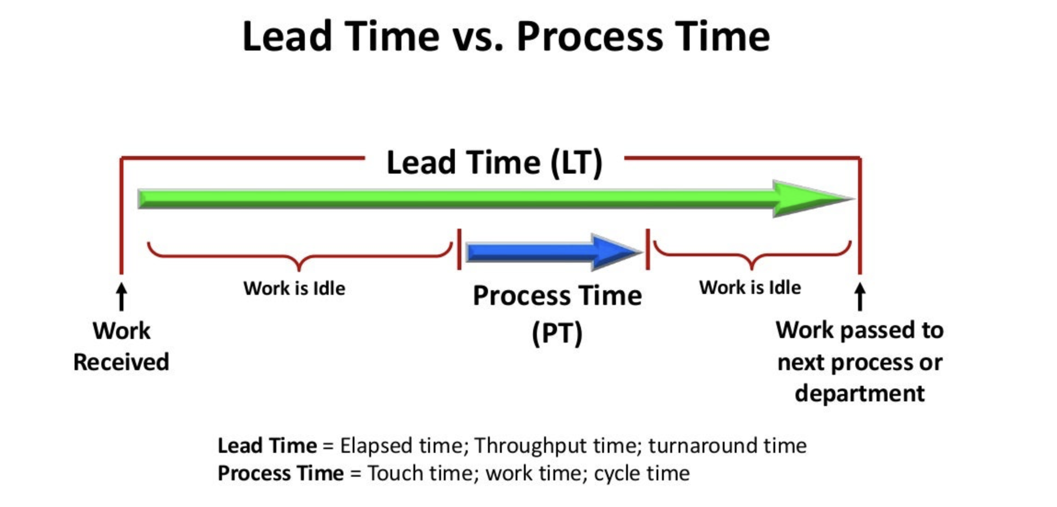
Cont.

Slide 5

The common scenario: Deployment lead times requiring months
• Problem Overview:
• In traditional setups, deployment lead times often extend for months, especially in large, complex organizations.
• Key Challenges:
• Monolithic Architecture: Tightly coupled systems hinder flexible deployments and changes.
• Scarcity of Testing Environments: Limited integration testing capabilities slow down the process.
• Manual Testing & Approvals: Heavy reliance on manual testing and multiple approval stages increase delays.
• Impact on Workflow:
• High potential for rework due to unexpected issues during integration.
• “Heroic” troubleshooting efforts are often required, leading to team burnout.
• Customer dissatisfaction due to delays and lower-quality releases.

Slide 6
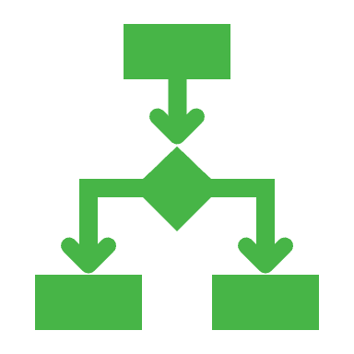
Devops ideal: Deployement lead times of minutes
• Ideal Scenario: Deployment lead times are reduced to minutes, allowing for rapid and continuous integration and deployment.
• Core Practices for Achieving This Ideal:
• Continuous Integration/Continuous Deployment (CI/CD): Automated pipelines that enable quick testing and deployment.
• Modular Architecture: Decoupled, encapsulated systems that allow independent deployments.
• Automated Testing: Ensures reliability and reduces the need for manual testing, speeding up releases.
• Benefits of Short Lead Times:
• Faster time-to-market for features and fixes.
• Higher team morale due to reduced rework and less pressure.
• Fewer customer-impacting issues and greater agility in responding to feedback.

Slide 7

Measuring rework with %c/a (percent complete and accurate)
• Definition: %C/A measures how often each step in the value stream produces output that doesn’t require rework.
• How %C/A is Calculated:
• By asking downstream teams how often they receive work that’s complete, accurate, and usable as is.
• Benefits of High %C/A:
• Less rework leads to smoother processes and faster delivery.
• Higher %C/A signifies stronger alignment and communication between teams.
• Example: A high %C/A means a developer receives requirements that are clear and accurate, reducing the need for follow-up clarification.

Slide 8

Flow metrics in the value stream
• Flow Velocity: Measures the number of work items completed in a set period. Indicates if value delivery is accelerating.
• Flow Efficiency: Ratio of active work time to total elapsed time. Low efficiency indicates significant waiting or bottlenecks.
• Flow Time: Measures the time for a unit of business value (e.g., features, fixes) to move through the value stream.
• Purpose of Flow Metrics:
• Identify inefficiencies in the process.
• Directly correlate improvements with business outcomes such as revenue or customer satisfaction.
• Make software development processes as transparent as production line operations.

Slide 9

conclusion
Effective management of the technology value stream leads to reduced lead times and less rework, enabling faster delivery of high-quality software.
The DevOps Ideal
Achieving short deployment lead times and high flow efficiency relies on CI/CD practices, modular architecture, and effective flow metrics.
Benefits of Optimized Value Streams
Optimized value streams result in faster delivery, enhanced quality, better alignment with business goals, and improved customer satisfaction.
Future Focus for Teams
Teams should focus on streamlining processes, automating tasks, and refining flow metrics to drive ongoing improvements and adaptability.

Slide 10

references
Kim, Gene, et al. The DevOps Handbook: How to Create World-Class Agility, Reliability, & Security in Technology Organizations. IT Revolution Press.
https://www.slideteam.net/media/catalog/product/cache/960x720/l/e/lead_time_vs_process_time_structure_slide01.jpg
https://www.metridev.com/metrics/lead-time-in-devops-a-key-to-efficient-software-delivery/

